Slide 1
REF POINTERS

Slide 2
Ref pointers are objects which behave like pointers but do more than a pointer. These objects are flexible as pointers and have the advantage of being an object (like constructor and destructors called automatically).
REF pointers prevent most situations of memory leaks by making the memory de allocation automatic
REF pointers may be implemented as a template class that mimics, by means of operator overloading.
REF pointers use reference counting which is a technique of storing the number of references, pointers, or handles to a resource such as an object
Few Examples:-
Cboproxy.cpp :- Status GetValues(std::map<CString,Ref<Node> > & pMapOfPath2Node) – second constructor
Cboproxy.cpp:- static BOProxyRef Acquire(CString &sSessionID,bool bAutoDestroySession/* = true*/,int32 iExpiresIn/* = 2 * 24 * 60 * 60*/) – first constructor

Slide 3
class Person {
int age;
char* pName;
public: Person(): pName(0),age(0) {
}
Person(char* pName, int age): pName(pName), age(age) {
}
~Person() { }
void Display() {
printf("Name = %s Age = %d \n", pName, age);
}
void Shout() {
printf("Ooooooooooooooooo",);
}
};
void main() {
Person* pPerson = new Person("Scott", 25);
pPerson->Display();
delete pPerson;
}
void main() {
SP p(new Person("Scott", 25));
p->Display(); // Dont need to delete Person pointer..
}

Slide 4
class SP {
private: Person* pData; // pointer to person class
public:
SP(Person* pValue) : pData(pValue) { }
~SP() { // pointer no longer requried
delete pData;
}
Person& operator* () {
return *pData;
}
Person* operator-> () {
return pData;
}
};
template < typename T > class SP
{
private: T* pData; // Generic pointer to be stored
public: SP(T* pValue) : pData(pValue) { }
~SP() {
delete pData;
}
T& operator* () {
return *pData;
}
T* operator-> () { return pData;
}
};

Slide 5
void main() {
SP<PERSON> p(new Person("Scott", 25));
p->Display(); // Dont need to delete Person pointer..
}
void main() {
SP<PERSON> p(new Person("Scott", 25));
p->Display();
{
SP<PERSON> q = p;
q->Display(); // Destructor of Q will be called here..
}
p->Display();
}
class RC {
private: int count; // Reference count
public: void AddRef() {
// Increment the reference count
count++;
}
int Release() {
// Decrement the reference count and
// return the reference count.
return --count; }
};

Slide 6
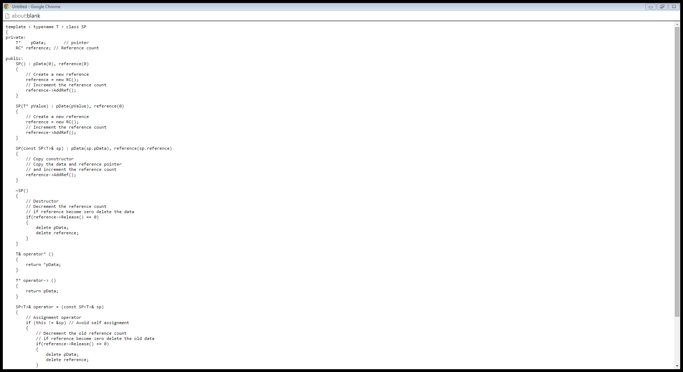
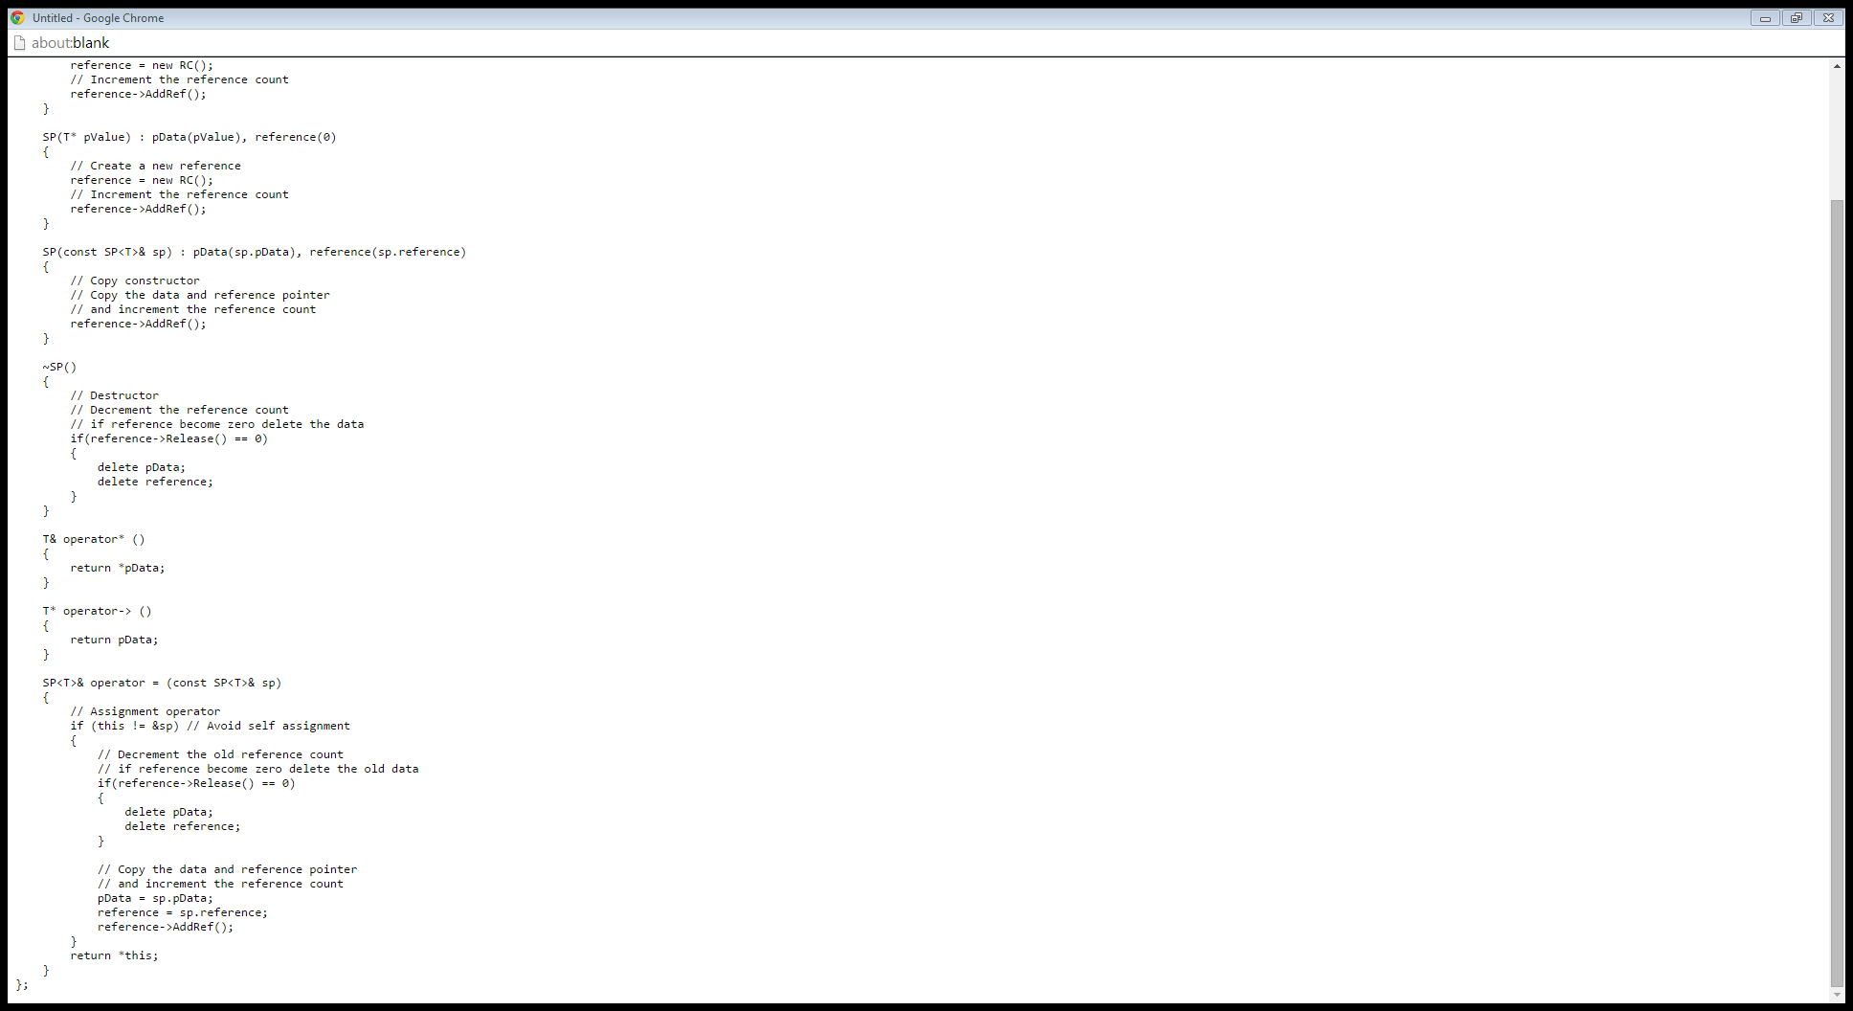

Slide 7
void main() {
SP<PERSON> p(new Person("Scott", 25));
p->Display();
{
SP<PERSON> q = p;
q->Display(); // Destructor of q will be called here..
SP<PERSON> r;
r = p;
r->Display(); // Destructor of r will be called here..
}
p->Display(); // Destructor of p will be called here // and person pointer will be deleted
}

Slide 9
MAKEFILES

Slide 10
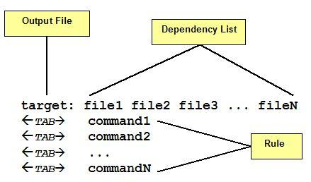
make [options] [target]
make -f run.mk (to run the filename other than makefile)
make command is invoked via runmk shell to process master makefile.
make requires a makefile that tells it how your application should be built. The makefile often resides in the same directory as other source files and it can have any name you want.
A make file consists of a set of targets, dependencies and rules. A target most of time is a file to be created/updated. target depends upon a set of source files or even others targets described in Dependency List. Rules are the necessary commands to create the target file by using Dependency List.
- tells make to continue processing even an error occurs and @ tells make not to print command before executing it.

Slide 11
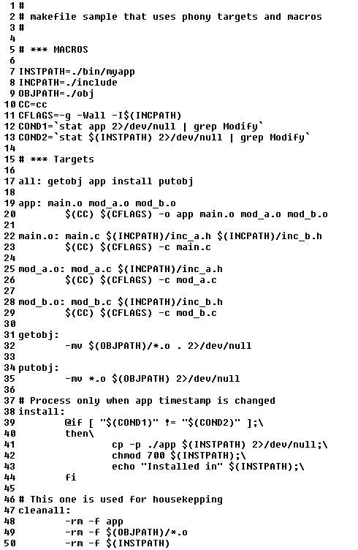

Slide 12
SYSROM_SRC(MakeFile):-
1)This is the First makefile which will be invoked when make is invoked from this path
2) This file declares all component targets (Third party components and own components )
3)When build target is all: then complete build takes place with recursive make calls
4) If multiple targets are given then each target is separated out and make of each component will be invoked.
5) call recursive make in each of the component directories based on what component directory is iterated.
6) Very clean : remove all .*0 ,.*lo,.*so,.*eap
7)Utility targets : bin etc include lib libexec private sbin share var
links to common and thirdparty bins, libs, etc based on build type
SUBST is a command on operating systems used for substituting paths on physical and logical drives as virtual drives;LINK VIRTUAL PATH WITH NEWLY CREATED DIR
8) Zapall : make with uninstall and very clean
Define the exceutable target and the executable objects and associated libraries
And call DoMake on the defined items
SYSROM_SRC(MakeFile):-
Dev(MakeFile)
Fill in SRC_DIRS CI ,AL, TOOL
And call DoMake
Fill in all SRC_DIRS in AL-Plugin
And call DoMake
Fill in all SRC_DIRS in JC and Call DoMake

Slide 13
DoMake:-
Used in each module's or library's makefile for building binaries, static libraries using common build macros, defs and rules.
defining all the build objs and build targets.
make starts from all: and runs each application one after the other
preprocess : pre processing arguments
subdirs : for each dir in SRC_DIRS calls make
sub targets : for each target on sub target do (MAKE -e) i.e on each of the build targets
post process: post processing
logresults : ignore errors and sucess || failure redirect to results.log
clean files : for build objects
10)very clean files : for build targets
11) uninstall files : removing all the sub dirs and sub targets
12) dountar:remove all the target dirs and then do TAR
13) config : setup config environment
14) dobuildtar : in the make env build all tardirs
15) cleantar : remove all the tar dirs

Slide 14
$? | list of dependencies changed more recently than current target.
$@ | name of current target.
$< | name of current dependency.
$* | name of current dependency without extension.

